Slide 1

WIPRO NGA Program – React + Java
Fullstack Batch
Capstone Project Presentation – 27 Aug 2024
Project Title - Inventory Management
Presented by - 1. Rohit Sahgal 4. Sainadh pati
2. Saishree Puskuri 5. Revathi Sodagam
3. Seshu Tippa 6. Ranga Prasad Thondamalla
www.rpsconsulting.in

Slide 2
Project Information :
Login and Registration : An admin user is present in the database. User will be displayed with Login screen. When the user enters the valid Admin User ID and Password, inventory Management dashboard will be shown. If the invalid UserID / Password is entered then user will be displayed a error message.
CRUD operations on Inventory : Admin user can able to perform crud operations on items of the store / Inventory of the store.
Raise the alarm for low Inventory : If any item is going down below the expected inventory level, raise an alarm to the Admin user and have the option to procure that item.

Slide 3



Technical Details Architecture
FRONTEND
• ReactJS
BACKEND
• SpringBoot
• SpringJPA
DATABASE
• MySQL

Slide 4




Technical Tools Used :
→ Visual Studio code (Version 1.92.2)
→ Spring Tool Suite (Version 4.24.0)
→ MySQL Workbench (Version 8.0)
→ Postman (Used VS code Extension Version 1.2.1)

Slide 5
Functionality of project
Inventory Management system, here you can efficiently manage your store's inventory.
Admin user can successfully login with valid credentials.
Admin can Keep track of stock levels, add new items, update and delete existing ones.
Admin user will get alerts when inventory is low. Then inventory products can be procured.

Slide 6
Initial Setup and Development
Set up the Development Environment and Installed Necessary Tools.
We have to setup Spring Tool Suite Tool and create the Spring starter project.
Add the dependencies and finish the development.
We have to set up MySql Server and MySql WorkBench and connect it with the Backend code.
We have to set up the the Visual Studio for React, finish the development connect it with the Backend code.

Slide 7
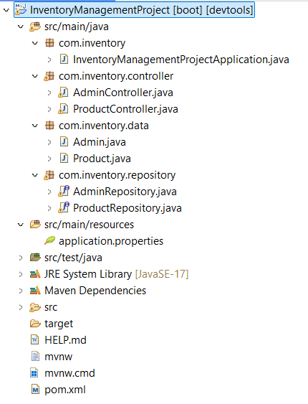
Backend File Structure:

Slide 8
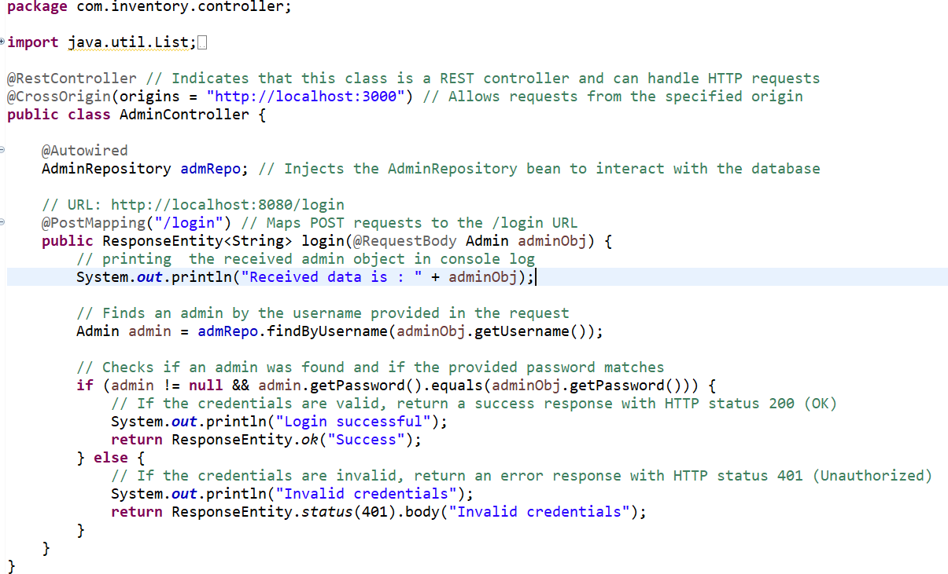
API Endpoints for Login on AdminController (POST Request):

Slide 9
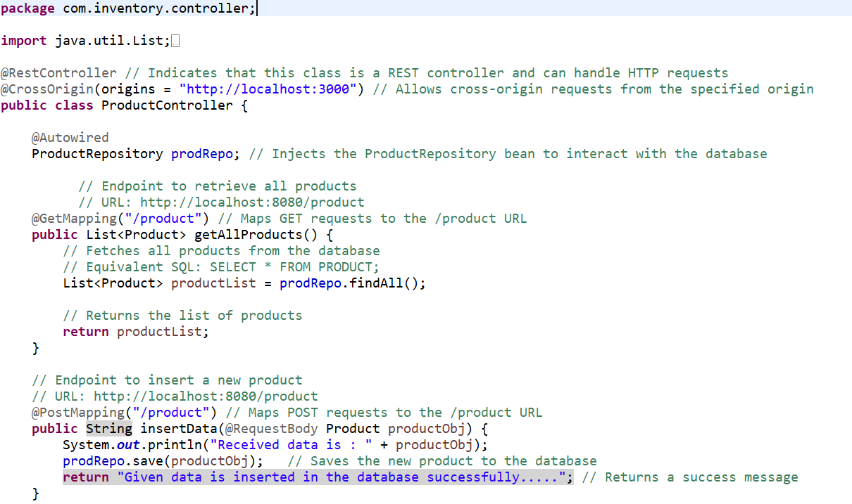
API Endpoints for Product on ProductController (GET and POST Request):

Slide 10
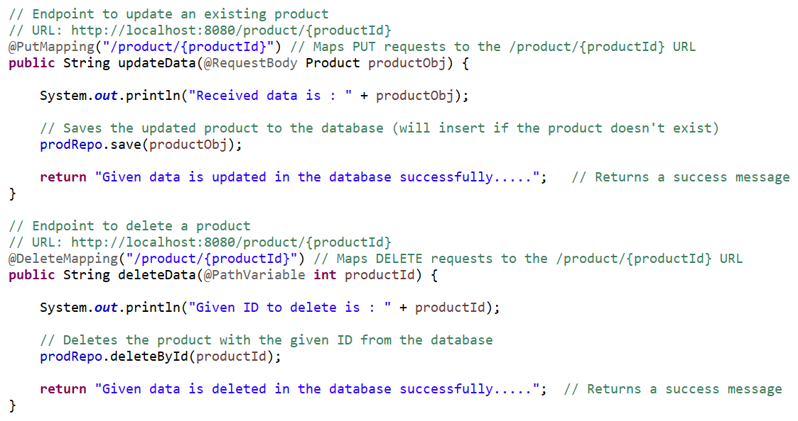
API Endpoints for Product on ProductController (PUT and DELETE Request):

Slide 11
HTTP Methods in Spring JPA
HTTP Methods enable API clients to perform CRUD(Create, Read, Update, Delete) actions on an API’s resources in an standardized and predictable way. The most commonly used HTTP methods are:
POST,GET, PUT, DELETE
POST:- POST method is used to insert the data, we have to send request to the end point. This includes Request Body.
GET:- GET request is used to retrieve the data on server.
PUT:- PUT is used to update the existing resource.
DELETE:- DELETE request is used to remove the data from database.

Slide 12
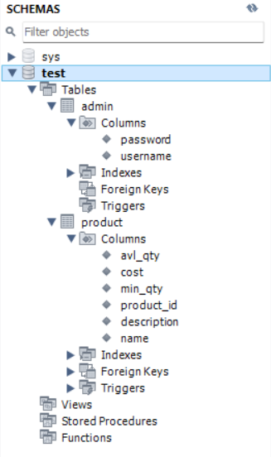
MySql Database Structure:

Slide 13
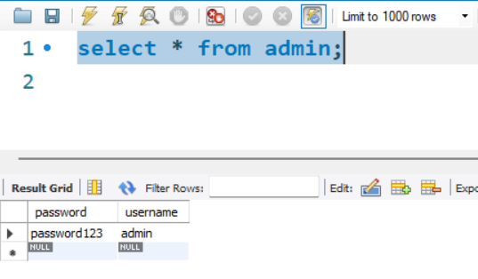
MySql Table Admin:

Slide 14
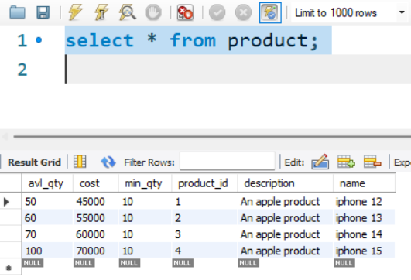
MySql Table Product:

Slide 15
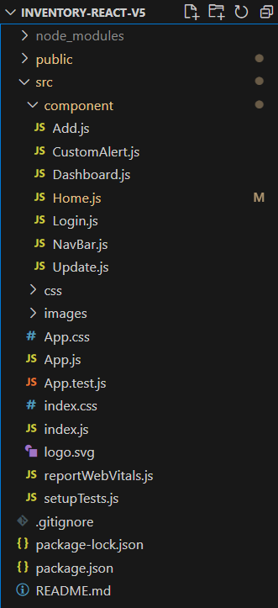
Frontend File Structure:

Slide 16
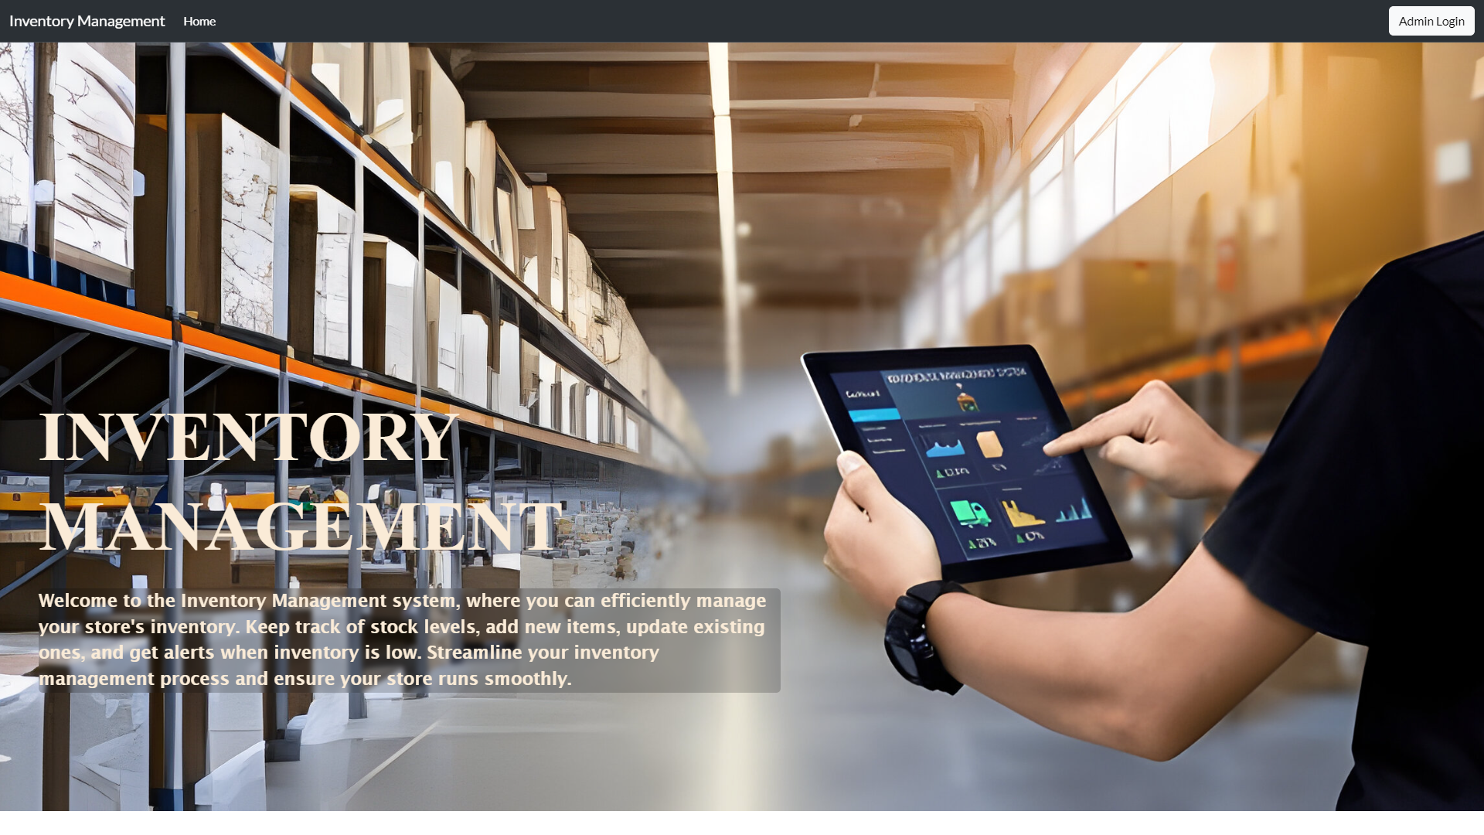
Homepage:

Slide 17

Admin Login Screen:

Slide 18
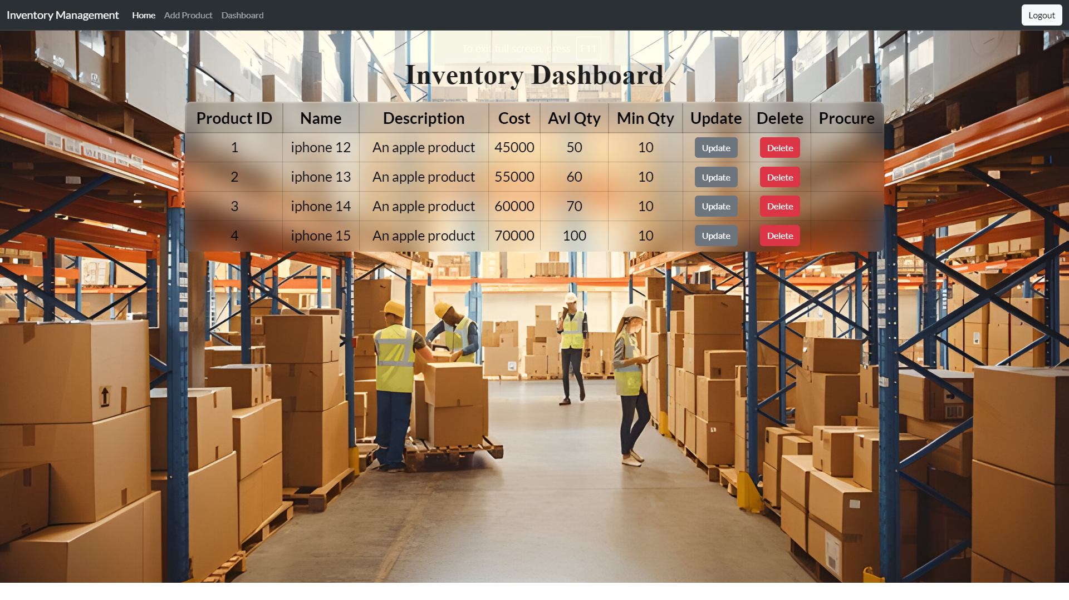
Dashboard:

Slide 19

Add Product:

Slide 20
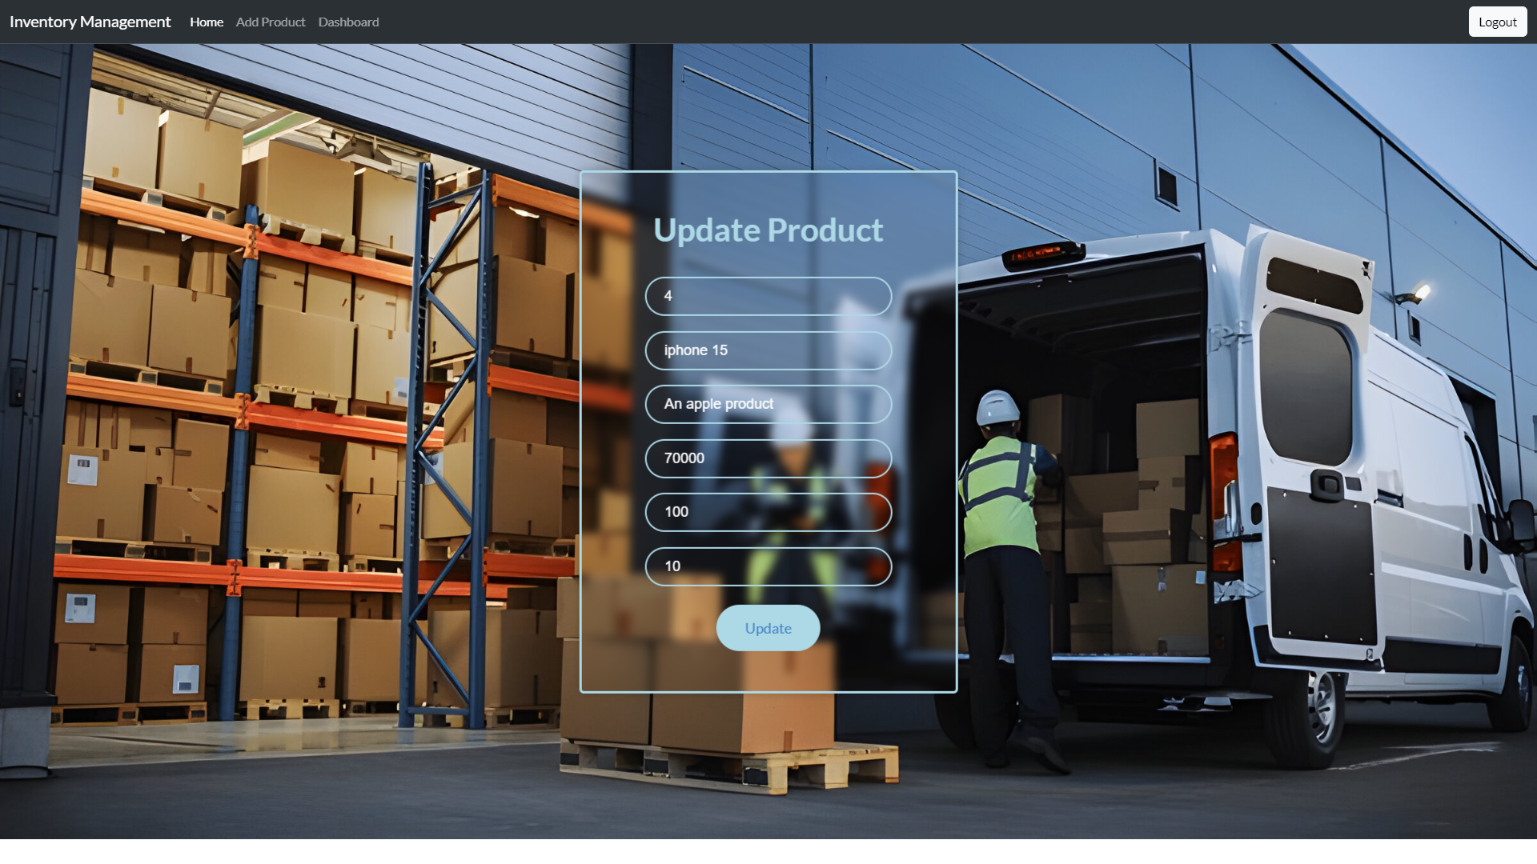
Update product:

Slide 21
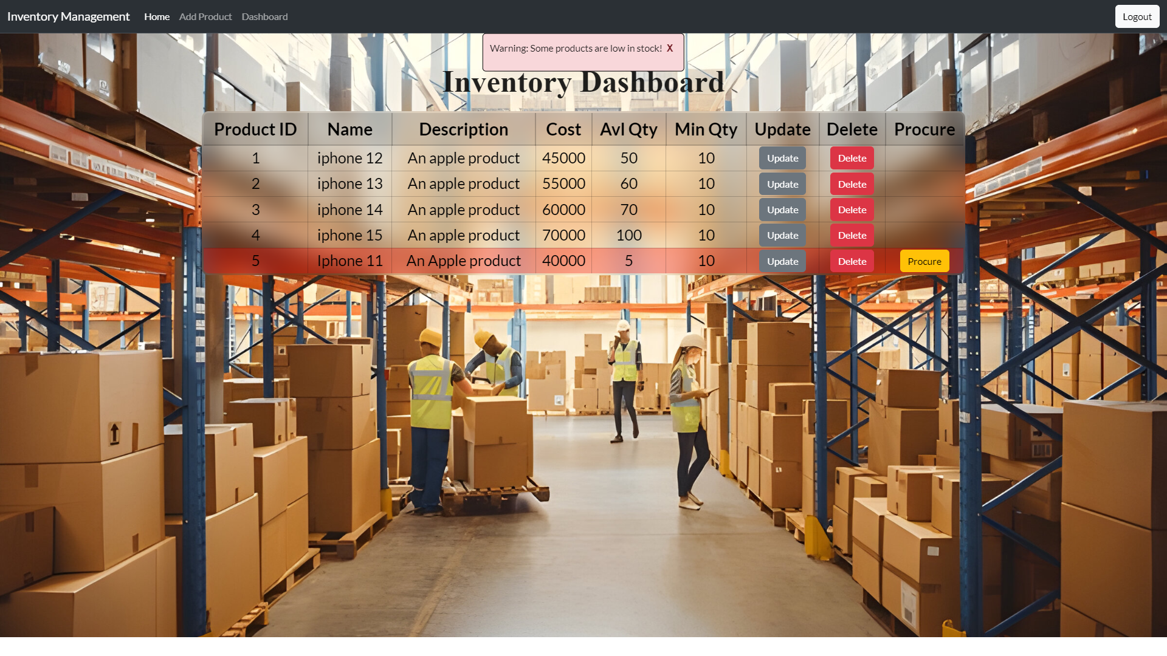
Raising Warning for low products :

Slide 22
Conclusion :
By doing this Inventory Management Project, we got good hands-on experience idea of Spring JPA, Spring Boot, React, MySql. Spring JPA makes it easy to easily implement JPA- based (Java persistence API) repositories. We have written the Spring JPA code in Spring Tool Suite. We used MySQL for database to store data. Used postman to test login and crud operations.
Here, we added the required dependencies, which makes the code reliable and we can easily import the required dependencies.
We received good knowledge on backend and Frontend and learnt how to integrate them.
At last, we successfully developed the frontend and backend which is connected with database.

Slide 23
References :
React Reference - https://react.dev/learn
Spring Boot Reference - https://spring.io/projects/spring-boot
Spring JPA Reference - https://spring.io/projects/spring-data-jpa
MySQL Workbench - https://www.mysql.com/products/workbench/

Slide 24
Thank You

